Slide 1
CHAPTER 5
Multivariate Probability Distributions

Slide 2
OBJECTIVES
Bivariate Normal Distribution

Slide 3
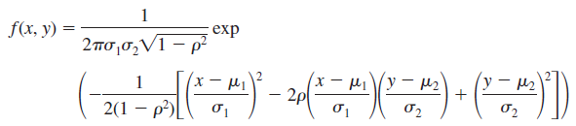
The Bivariate Normal Distribution
Just as the most useful univariate distribution in statistical practice is the normal distribution, the most useful joint distribution for two rv’s X and Y is the bivariate normal distribution.
The pdf is somewhat complicated:
It is not at all straightforward to integrate the bivariate normal pdf in order to calculate probabilities.
Instead, selected software packages employ numerical integration techniques for this purpose.

Slide 4
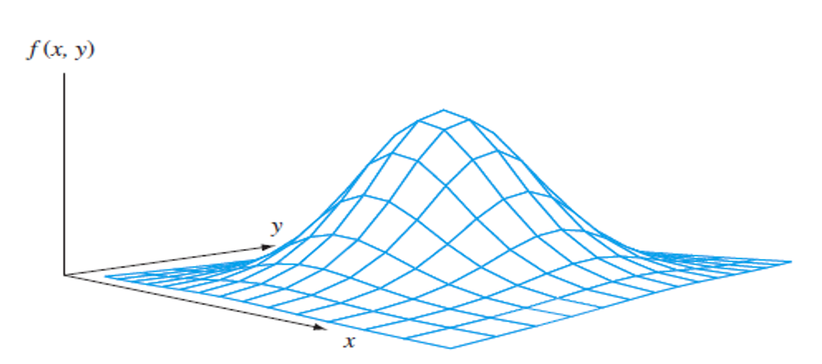

The Bivariate Normal Distribution
A graph of this pdf, the density surface, appears in Figure below.
It follows (after some tricky integration) that the marginal distribution of X is normal with mean value $μ_{1}$and standard deviation $σ_{1}$, and similarly the marginal distribution of Y is normal with mean $μ_{2}$ and standard deviation $σ_{2}$.
The fifth parameter of the distribution is $ρ$, the correlation coefficient between X and Y given by $\frac{Cov(X,Y)}{σ_{X}σ_{Y}}$ .

Slide 5
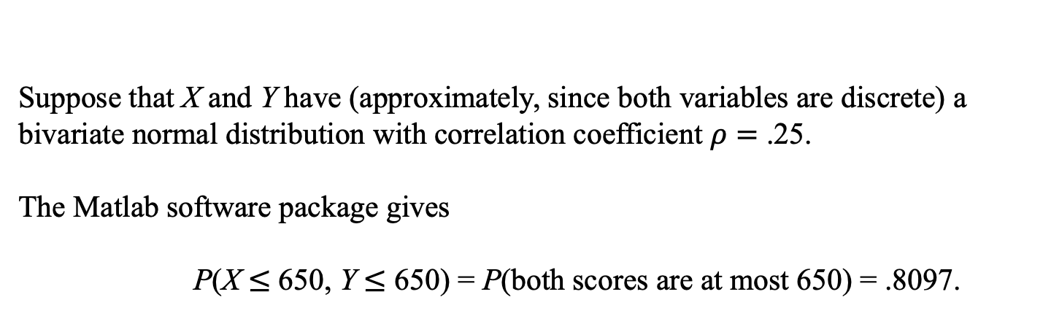

Example
Many students applying for college take the SAT, which for a few years consisted of three components: Critical Reading, Mathematics, and Writing.
While some colleges used all three components to determine admission, many only looked at the first two (reading and math).
Let X and Y denote the Critical Reading and Mathematics scores, respectively, for a randomly selected student.
According to the College Board website, the population of students taking the exam in Fall 2012 had the following characteristics:
$$μ_{1}=496, σ_{1}=114, μ_{2}=514, σ_{2}=117.$$
Suppose that X and Y have (approximately, since both variables are discrete) a bivariate normal distribution with correlation coefficient $ρ=$ .25.
The Matlab software package gives
P(X $≤$ 650, Y $≤$ 650) = P(both scores are at most 650) = .8097.

